Slide 1

Earning Your Business Daily
Fall 2025

Slide 2






BPS “F.I.R.S.T”
Focused: The BPS Team is dedicated to program business
Innovative: We help our Partners grow through system solutions, geographic expansion, and product development
Responsive: Our flat structure and direct access to the Leadership Team creates a nimble culture that allows our Partners to be opportunistic
Service Oriented: We deliver and measure our Underwriting and Claims responsiveness to uniquely ensure our Partners’ needs are met
Trustworthy: We are transparent & collaborative with our Partners allowing them to be more successful

Slide 3
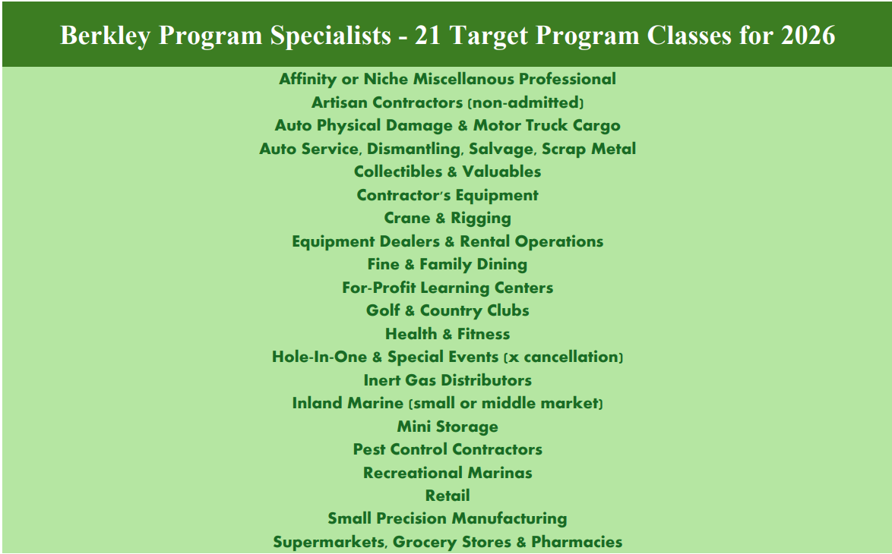
BPS Target Classes

Slide 4
Collaborative Submission Process
Our commitment is to deliver BPS’ contribution to due diligence in under 70 business days
1
2
3
4
Initial Program
Submission
Response
Leadership Team Review of Executive Summary
Nondisclosure Agreement Execution
Actuarial Data Analysis & Underwriting Review
5 DAYS
5 DAYS
5 DAYS
20 DAYS
5
6
7
Program Application &
Requirements Meeting
Actuarial, Underwriting, Finance, Claims, IT & Operational Due Diligence
Program Proposal Delivered
5 DAYS
30 DAYS
Notes:
Talking Points:
- Our flat organizational model allows us to move swiftly in the new business process and ensure your program gets attention from our senior staff. When we say actuarial, we mean the Chief Actuary. When we say underwriting, we mean our CUO. Because of our approach, your program is getting our most seasoned people. From the start, you are in direct communication with decision-makers so you don’t have to worry about your message getting filtered by others.

Slide 5
Effective Implementation Process
Our commitment is to speed and efficiency in the Implementation Process
Execute Contract
Finalize Product Offering
Create & Submit Rates/Rules/Forms Filings
Finalize UW Guidelines & LOAs
Finalize Claims Handling Procedures
Deploy ‘Rate/Bind/Issue’ Systems
Finalize Carrier Data Needs
LAUNCH!
Notes:
Talking Points:
- Our flat organizational model allows us to move swiftly in the new business process and ensure your program gets attention from our senior staff. When we say actuarial, we mean the Chief Actuary. When we say underwriting, we mean our CUO. Because of our approach, your program is getting our most seasoned people. From the start, you are in direct communication with decision-makers so you don’t have to worry about your message getting filtered by others.

Slide 6







Due Diligence Checklist
Actuarial
Historical Premium by LOB & State
Detailed Loss Runs
Rating Algorithms/ LCMs
Rate Changes
Large Loss Descriptions
Underwriting
Guidelines
Limits Profile
Staff Resumes
Forms & Rates
Competitor Details
Underwriting Files
Finance
Financial Statements
Insurance Coverage
Premium Trust
Disaster Recovery
Accounting Practices
IT
Operational Processes/Controls & Supporting Systems
Data Reporting Requirements
Claims
TPA Knowledge & Guidelines
Licenses & Compliance
Systems & Data Collection
Disaster Recovery
Marketing
Marketing/ Sales Plans
Activities Executed & Results
Notes:
Due Diligence Detail:
Actuarial: Chief Actuary
Underwriting: CUO conducts an on-site observation and file review followed by additional assessment of rates, forms, filings, guidelines, processes, lines of business and limits.
Financial: CFO examines financial statements, tax returns, insurance coverage, premium trust and disaster recovery plan and interviews PA to validate accounting processes, disbursements, receivables and internal controls.
IT: CIO collects information on PA rate/quote/issue/billing system(s), capabilities and design to determine adequacy and confirms PA’s ability to meet BPS data reporting requirements.
Claims: CCO assesses TPA expertise, DOI licenses, claims system, data transmission/, disaster recovery plan
Marketing: Director reviews marketing, sales and/or growth plans, recent activities executed and

Slide 7
What do we look for in a prospective program?
Robust, credible data sets
Underwriting acumen and expertise
Niche portfolios: specialty GL, inland marine, low-CAT property
Consistent profitability
Long-term, collaborative partnerships
Strong distribution relationships
Partners in search of risk-bearing capacity

Slide 8
Start-Up Programs
Appetite
An experienced team within an existing Program Administrator
Industry or other data available for
actuarial benchmarking
Experience
Data
Risk Appetite
Non-Admitted
Non-admitted
to provide
flexibility
Focused niche classes of business

Slide 9
Transparency
We work with our program administrators throughout the year to align expectations, identify enhancements, monitor progress and deepen our relationships
Ad Hoc
Referrals
Form Refresh/ Development
Custom Actuarial Analysis
Risk Alerts
Monthly
Reporting (e.g. Policy, Claim, Production,
Account Current,
Loss Runs)
Rate Monitor
Quarterly
Program Dashboards
Semi-Annually
Stewardship Meetings
Pricing Reviews
Underwriting Audits


Annually
Business Planning
Cross-Functional Program Meeting
Networking Event
Financial Audit


●

Slide 10

Accountability. Integrity. Transparency.
Every company has the ability to react as quickly and effectively as a small business while offering the stability and resources of W. R. Berkley Corporation
Excess & Surplus | Regional | Product Specialty | Industry Specialty | Reinsurance | International
Admiral Insurance Berkley Aspire Berkley Custom Berkley Regional Specialty Nautilus Vela Verus | Acadia Berkley Mid-Atlantic Group Berkley North Pacific Berkley Southeast Continental Western Group Union Standard | Berkley Accident & Health Berkley Crime Berkley Cyber Risk Solutions Berkley Design Professional Berkley Environmental Berkley Fire & Marine Berkley Global Product Recall Management BerkleyNet Berkley Prime Transportation Berkley Product Protection Berkley Risk Berkley Select Berkley Surety Gemini Key Risk Midwest Employers Preferred Employers | Berkley Agribusiness Berkley Alliance Berkley Asset Protection Berkley Aviation Berkley Construction Berkley Entertainment Berkley FinSecure Berkley Healthcare Berkley Human Services Berkley Industrial Comp Berkley Luxury Berkley Life Sciences BerkleyMed Berkley Offshore Berkley Oil & Gas Berkley One Berkley Public Entity Berkley Renewable Energy Berkley Risk Berkley Specialty Berkley Technology Carolina Casualty | Berkley Re America Berkley Re Asia Pacific Berkley Re Australia Berkley Re Solutions Berkley Re UK Berkley Program Specialists | Berkley Argentina Berkley Brazil Berkley Canada Berkley Columbia Berkley Deutchland Berkley Espana Berkley Insurance Asia Berkley Insurance Australia Berkley International Puerto Rico Berkley Latin America Berkley Mexico Berkley Nordic Berkley Uruguay W. R. Berkley Europe W/R/B Undewriting
Everything Counts, Everyone Matters ®
Notes:
Sources:
2016 CIAB Discussion Guide
Notes: Company names are abbreviated per the CIAB reference.
Berkley Re America, Berkley Re Asia Pacific, Berkley Re Direct, Berkley Re UK and Berkley International Latinoamerica are not listed on the W. R. Berkley Website under the operating units.
Berkley ART Argentina, Berkley Argentina Reaseguros, Berkley International Do Brasil Seguros, Berkley International Seguros, Berkley International Seguros Columbia, Berkley International Seguros (Uruguay) are listed on the website but not in the CIAB chart.

Slide 11
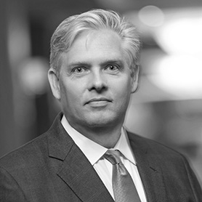
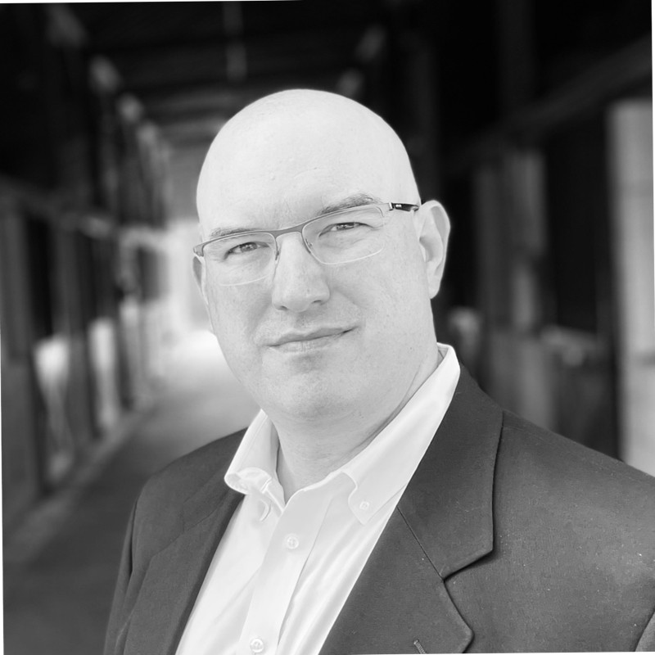
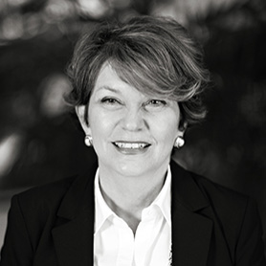
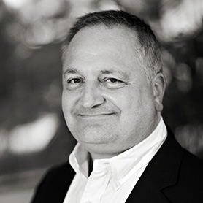
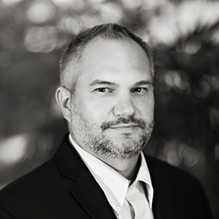
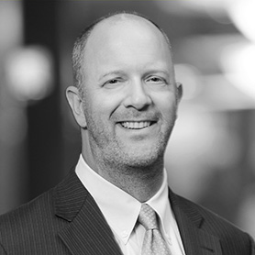
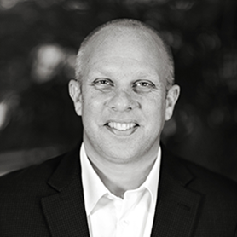
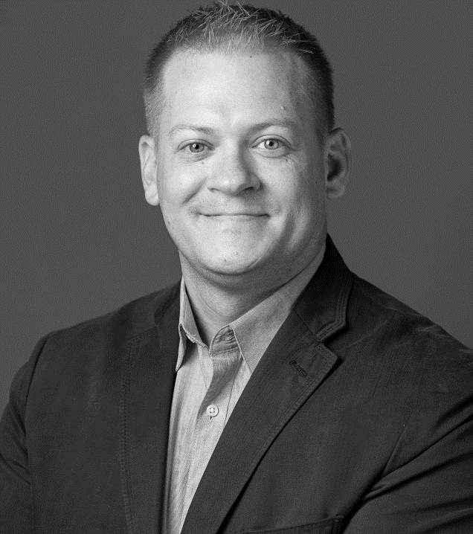
Contacts
Greg Douglas
President
t. 630.210.0340
e. gdouglas@wrberkley.com
Joe Piekarski
Chief Claims Officer
t. 630.210.0422
e. jpiekarski@berkley-ps.com
Jackie Bourret
Chief Underwriting Officer
t. 630.210.0401
e. jbourret@berkley-ps.com
Julius Colangelo
Chief Information Officer
t. 630.210.0341
e. jcolangelo@berkley-ps.com
Kevin Novak
Chief Administrative Officer
t. 630.210.0355
e. knovak@berkley-ps.com
Peter Corrigan
Business Development Officer
t. 216.978.1652
e. pcorrigan@berkleyre.com
Spencer Coyle
Chief Actuary
t. 630.210.0364
e. scoyle@berkley-ps.com
Kevin Landers
AVP Business Development
t. 901.341.3540
e. klanders@berkley-ps.com

